Slide 1


Recovery Café San José
Final Presentation
Overview
Processes, Results, & Recommendations
Cameron Kemske
Brittany Prock
Valentina Estrada
Notes:
Cameron

Slide 2
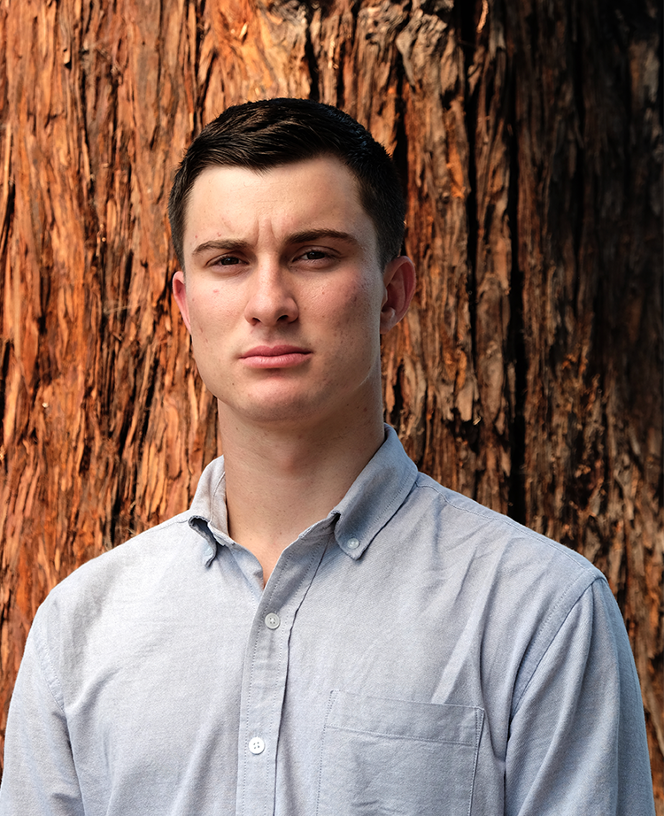
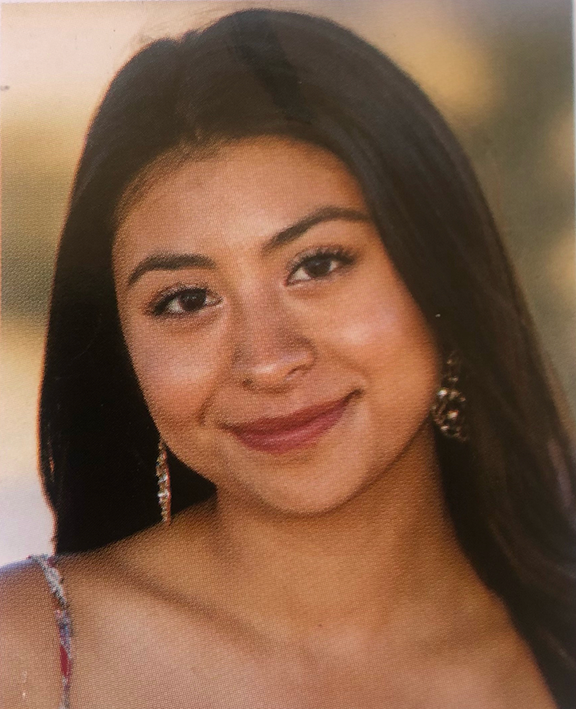
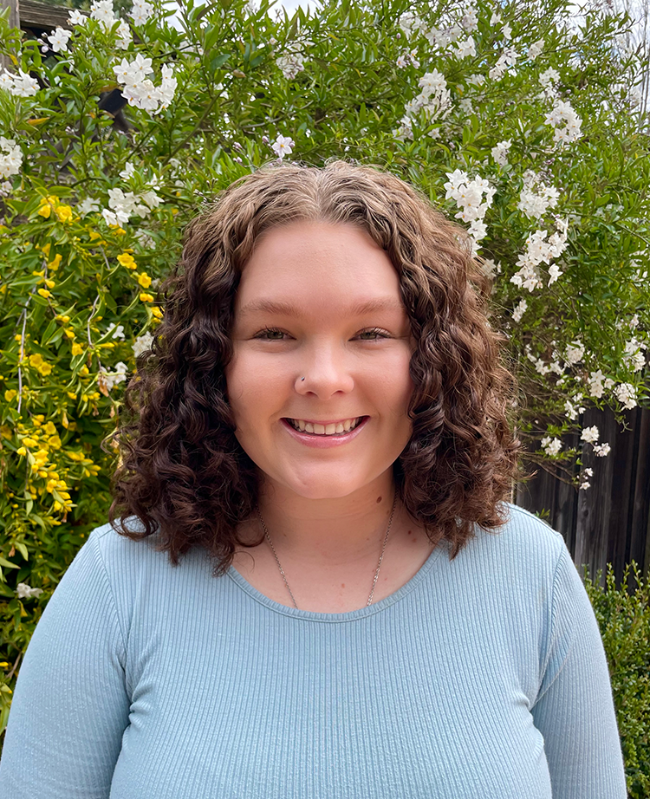
Meet the Team
Cameron Kemske
Project Lead
Valentina Estrada
Communication Liaison
Brittany Prock
Copy Editor

Slide 3
Overview of Presentation
Project Scope
How can we use marketing strategies to boost awareness of RCSJ?
Phase 1 & 2
Data Collection
Phase 3
Testimonial Creation
Phase 4
Social Media Campaign for Fundraising Event
Web Page Design
Conclusion
Notes:
Cameron

Slide 4
Phase 1 & 2
Initial Research & Data Confirmation
Notes:
Brittany

Slide 5
Phase 1 & 2 Recap
Phase 1 Objective: determine common motivators for financial support
Phase 1 Results:
Interviewed 26 previous RCSJ supporters & 3 Cisco employees
Impromptu corporate strategy research
Phase 2 Objective: confirm most common responses from Phase 1
Phase 2 Results:
Clean and safe refuge, island of safety and stability, & strong sense of community
Corporations wish to see proven success through data & alignment of missions
Notes:
Brittany

Slide 6
Phase 3
Testimonial Creation
Notes:
Brittany

Slide 7
Phase 3 Results
Phase 3 Objective: Utilize our findings from Phase 1 and 2 to create high quality video style testimonials
Phase 3 Process/Results:
Formulated questions based on the responses of our Phase 2 survey
Interviewed an RCSJ member and board member, received video from a city councilman
Created a narrative-based testimonial to make an emotional appeal & 2 authentic/credible testimonials to make a logical appeal
Notes:
Brittany

Slide 8
Phase 4
Social Media Campaign
Notes:
Valentina

Slide 9
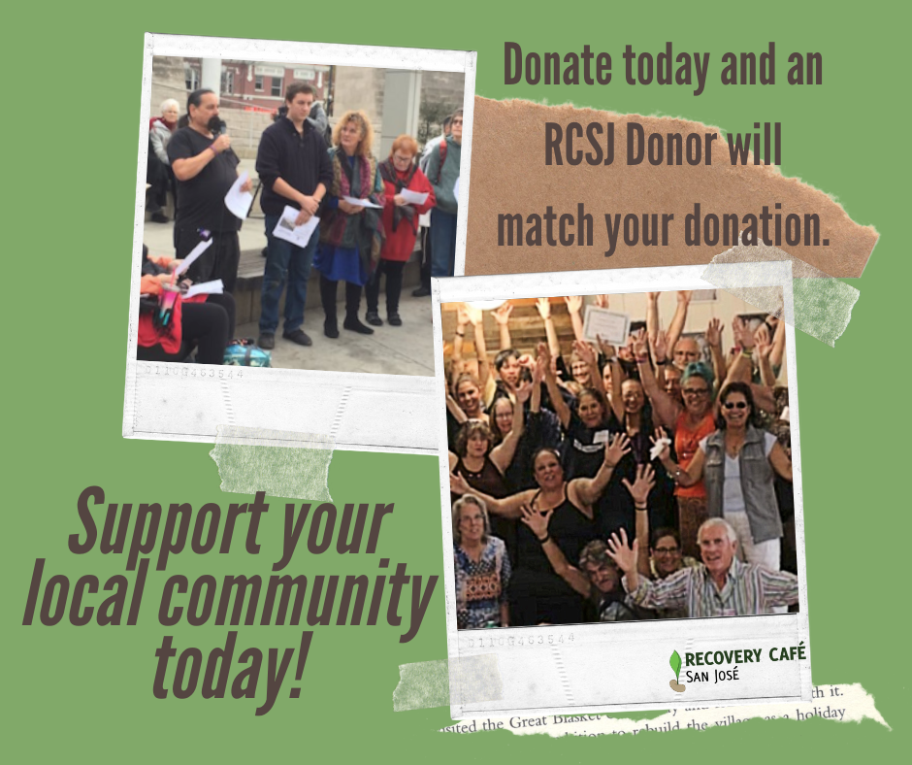
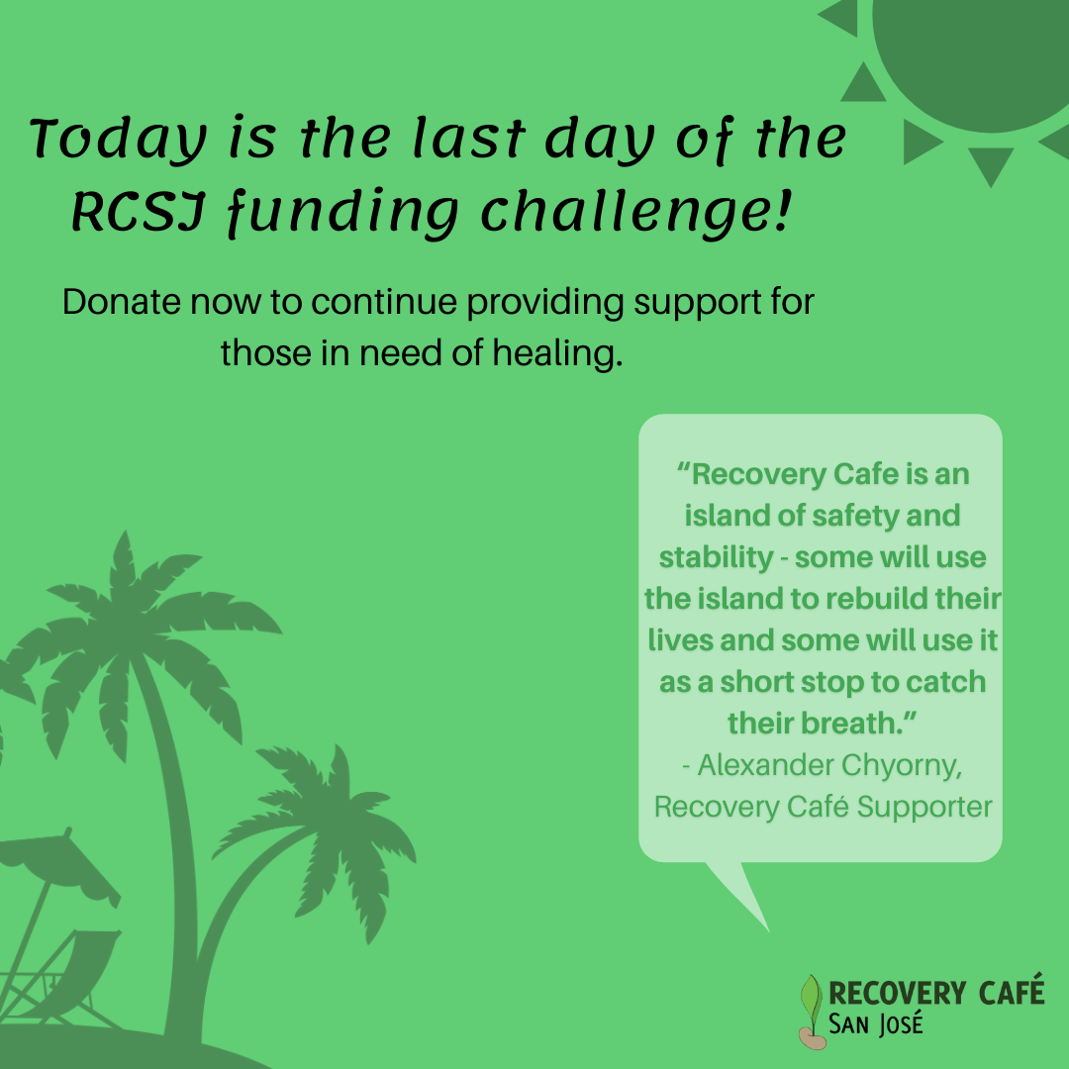
Strategic Social Media Posts

Slide 10
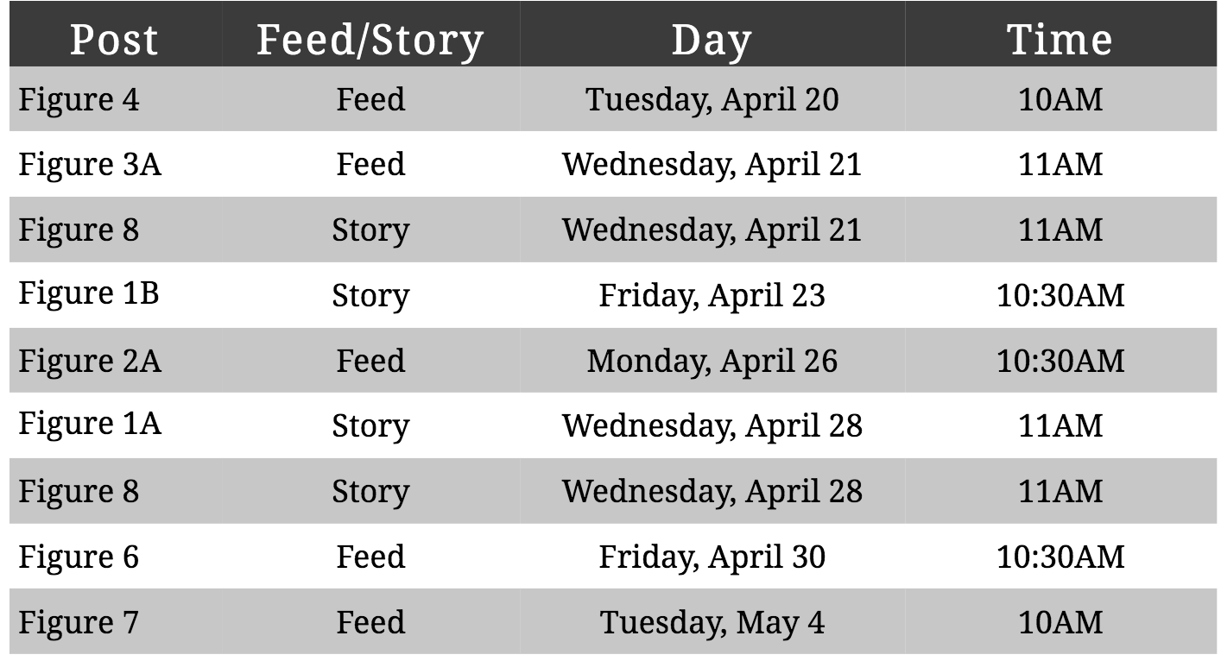
Facebook Posting Schedule

Slide 11
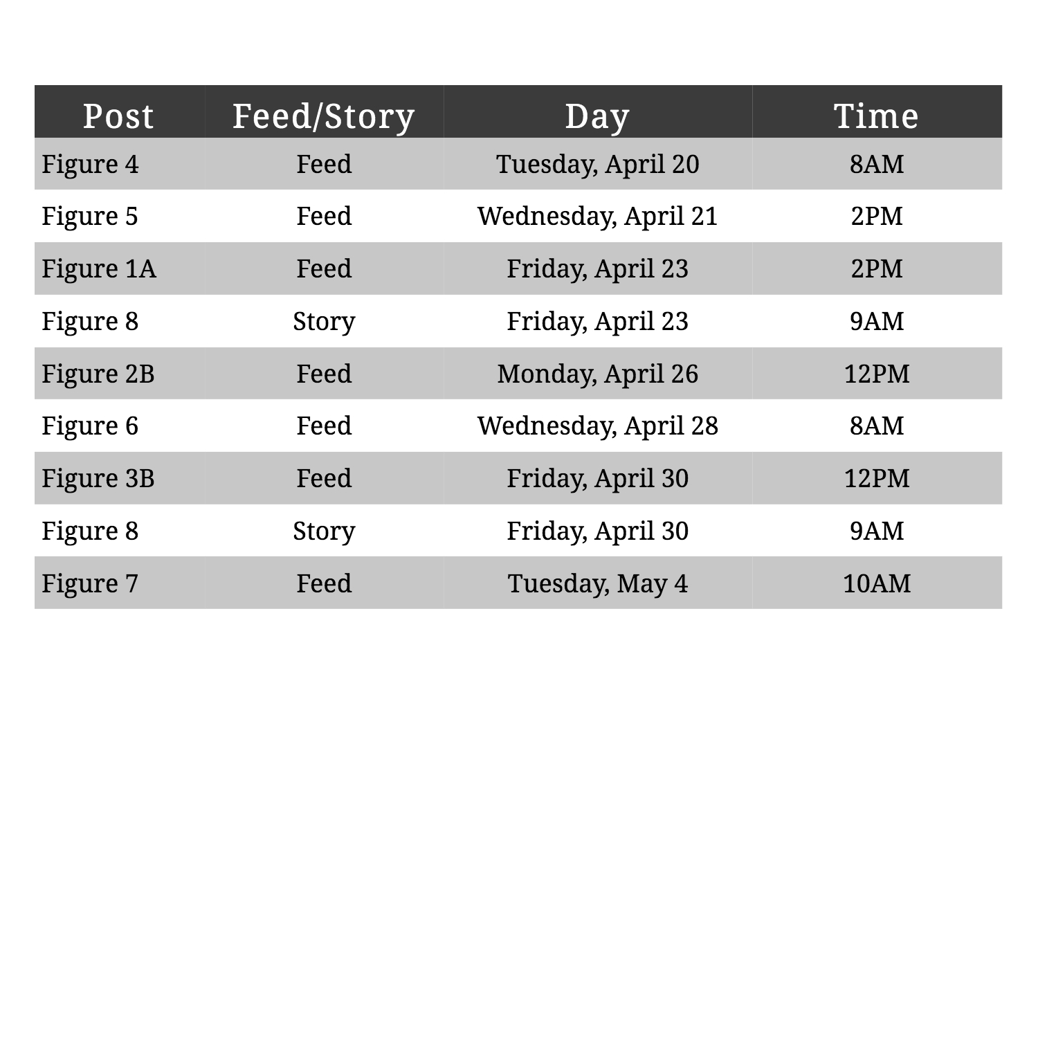
Instagram Posting Schedule

Slide 12
Phase 4 Results
Results:
Unable to track social media analytics
Recommendations:
Two to three week social media campaigns to promote events
Use recommended posting schedule for future campaigns
Use data from phase 1 and 2 to create future posts

Slide 13
Phase 4
New Web Page Design
Notes:
Cameron

Slide 14
Web Page Design Package
Objective: Create a comprehensive and concise document package of the various marketing techniques we used throughout our development of the video testimonials to aid with immediate implementation of those video assets.
Deliverables
Editing Guidelines
Opaque Watermark
Pool of Questions
Title and Description Text Document
Web Page Design Files

Slide 15
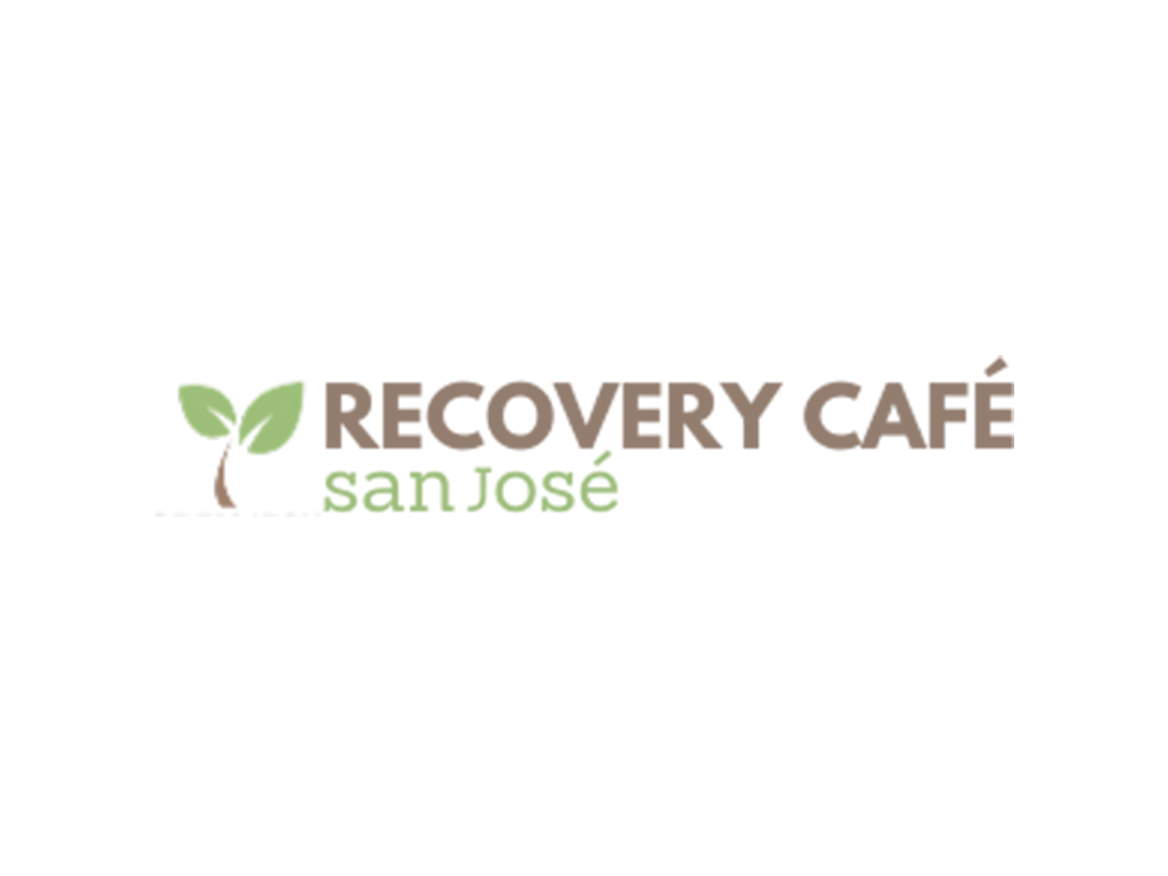
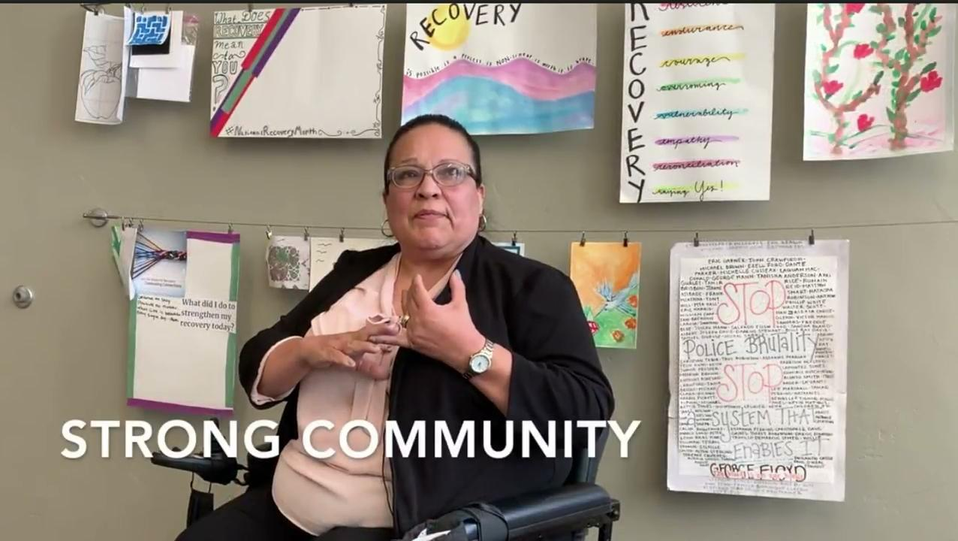
Editing Guidelines
Example of Transition and Text
Example of Watermark

Slide 16
Pool of Questions
Four Question Pools
Ms. Carreras
Mr. Detering
Mr. Peralez
Jane Doe
Five Questions Total for Each
Explanation/Reasoning behind asking that specific question
Examples of Follow-up Questions
Can you give an example?
How did that make you feel?
What were you thinking when that happened?

Slide 17
Titles & Description Document
Main Components
Title text for each web page
Description text for each web page
Summaries for each of the interviewees
All text is subject to change based on current branding and objectives. This document aims at providing a template for quick implementation.

Slide 18
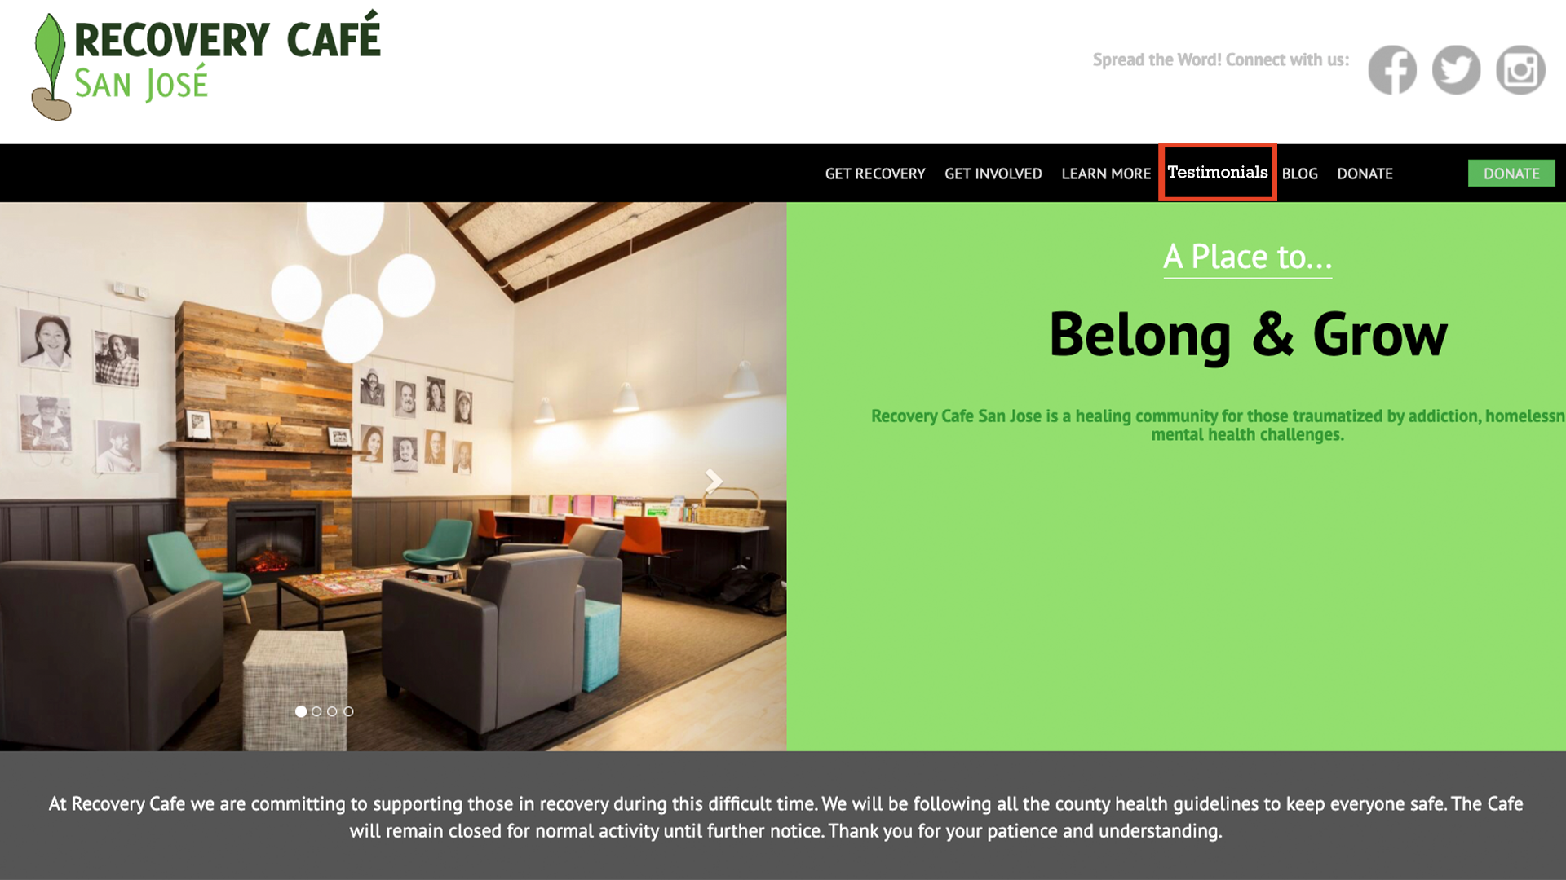
Landing Page

Slide 19
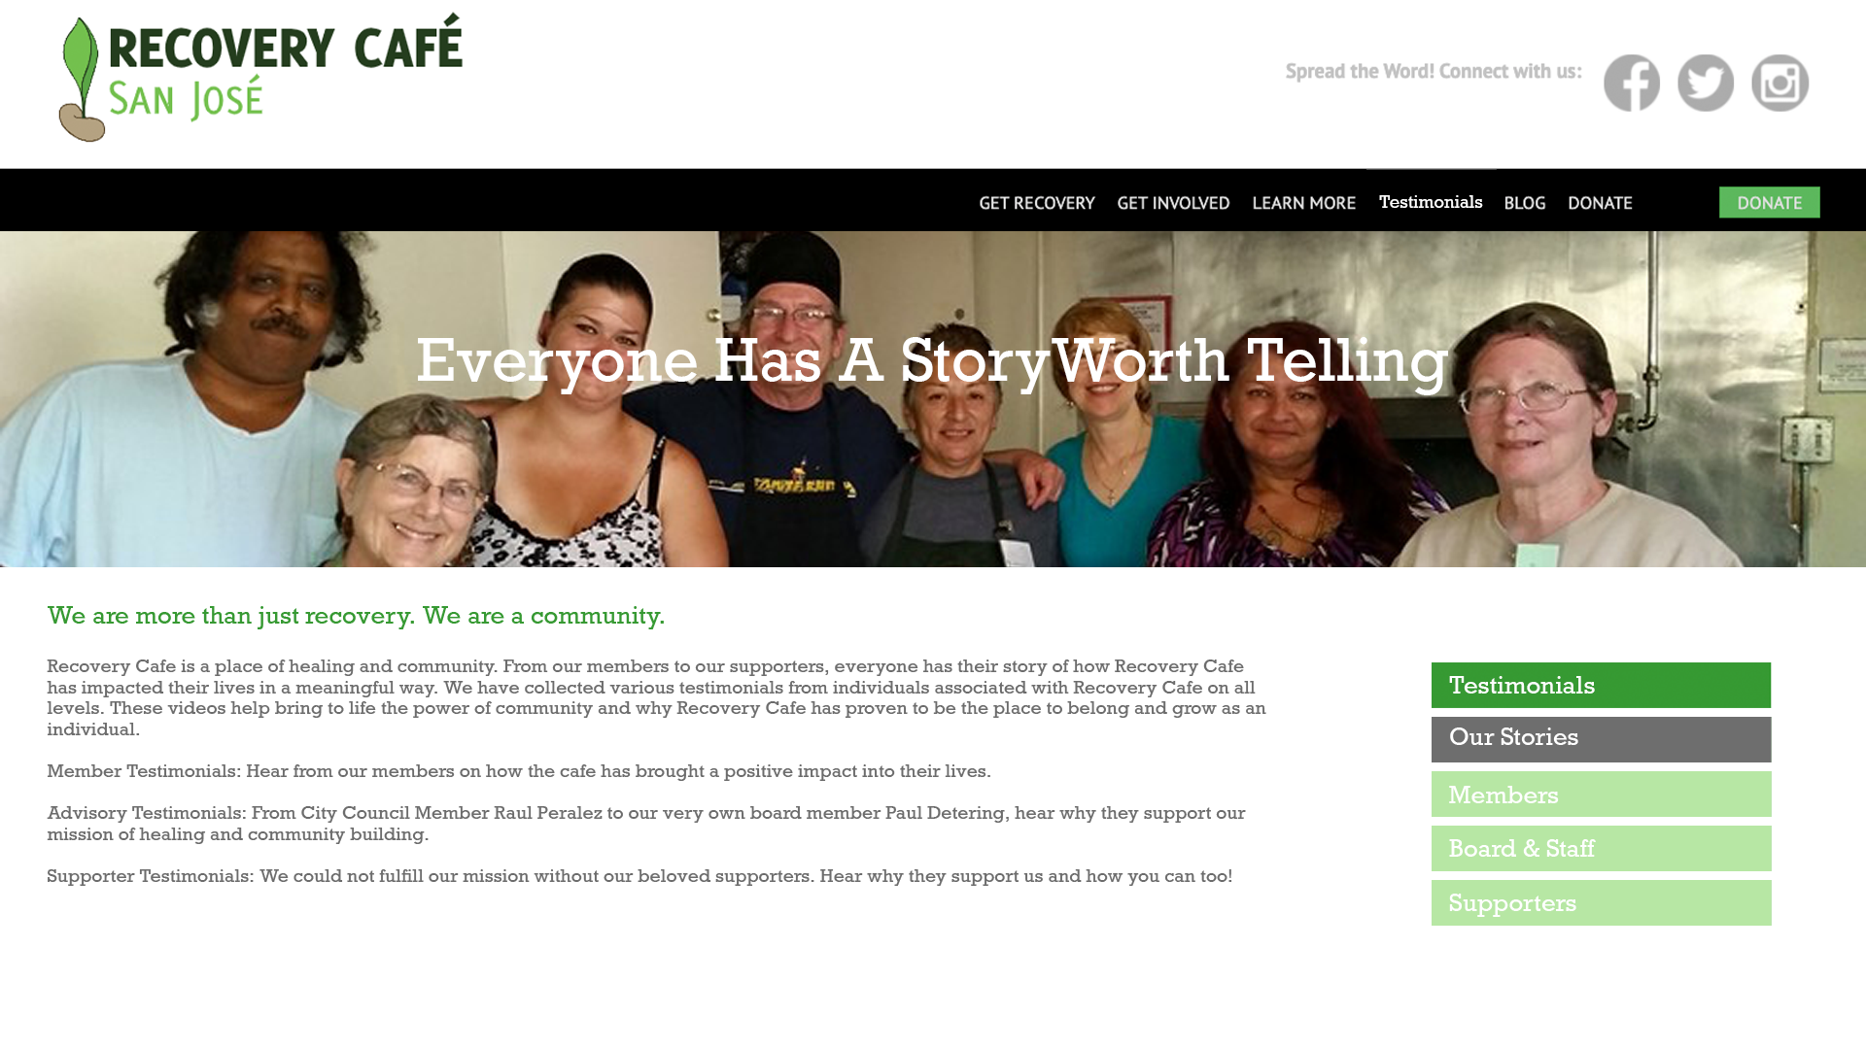
Main Testimonial Page

Slide 20
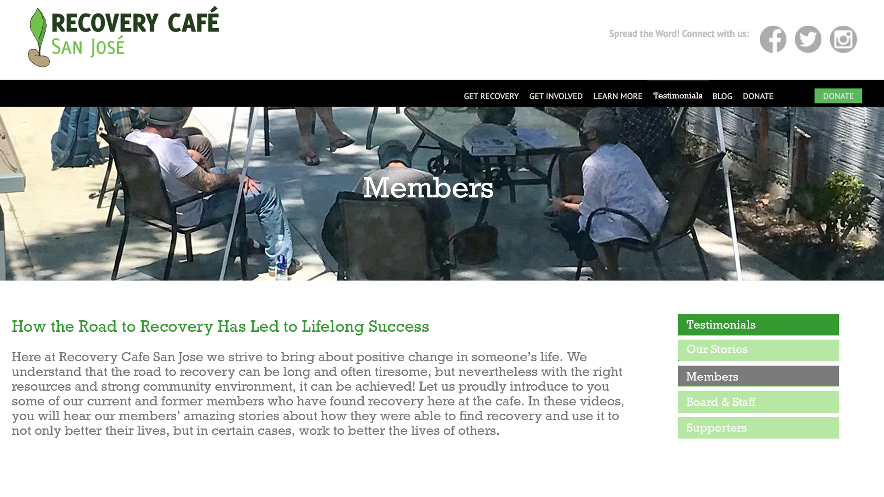
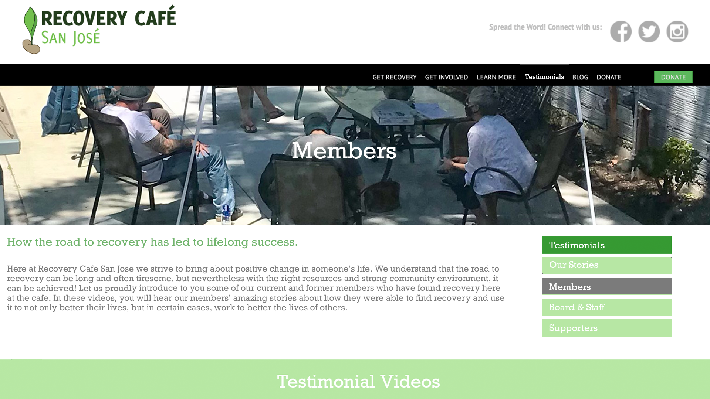
Members Example Page

Slide 21
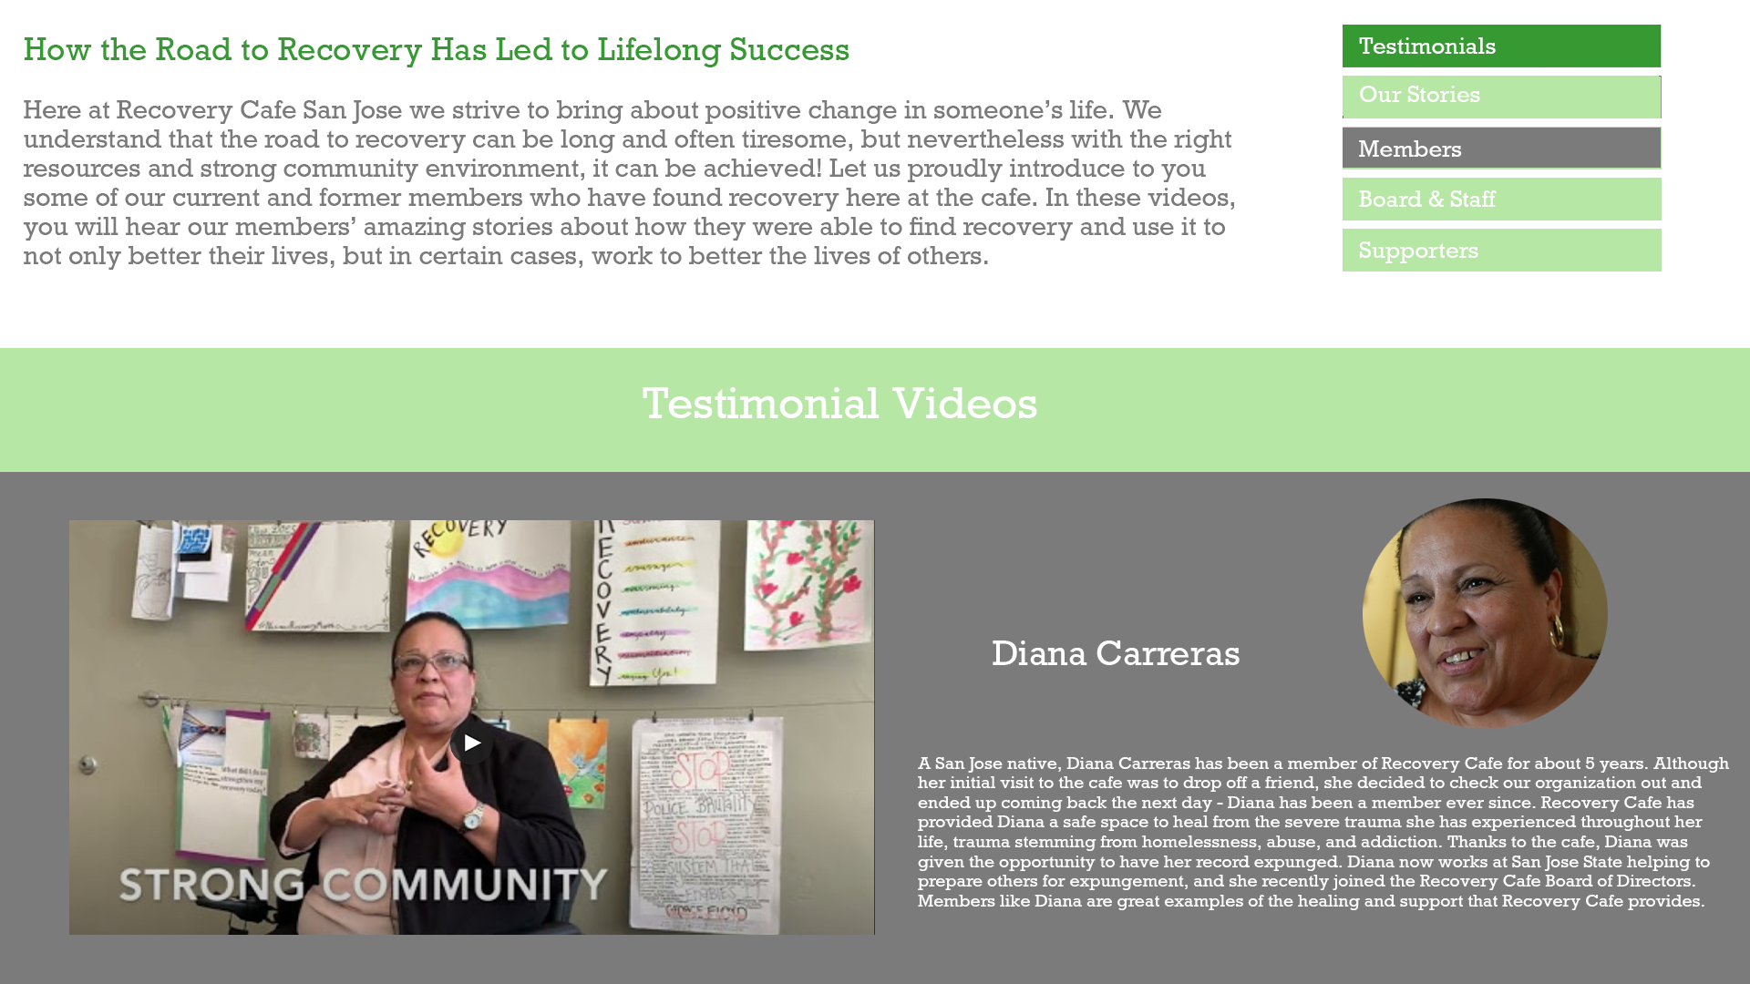
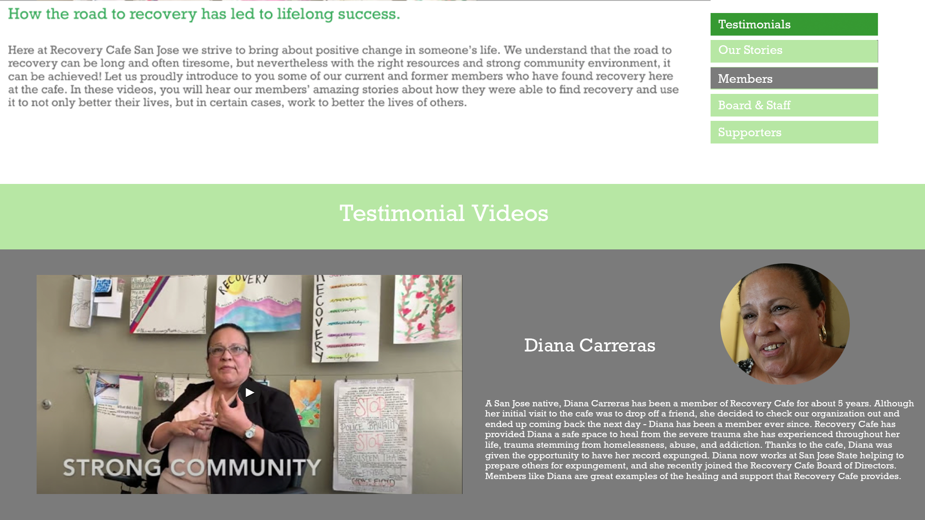
Members Example Page Cont.

Slide 22
Additional Web Pages
Board & Staff Page
Title Text: Meet the backbone of our organization
Background Image: Board meeting or staff engaging in work-related activities
Supporter Page
Title Text: Meet the amazing individuals whose generosity continues our great work
Background Image: 2019 In-Person Closing the Gap Fundraising Event

Slide 23
Corporate Outreach Results
Notes:
Cameron

Slide 24


Main Strategy
Insights from Cisco
“Success through data”
“Alignment of key services and mission”
Metrics to use
Total Training Time Conducted
Average Training Time Per Member
Employment Secured After Recovery
Where is the value?
These organizations are focused on “long term recovery” for the Bay Area food industry.
Restaurant industry is seeing a shortage of employees after the pandemic.
Bay Area Hospitality Coalition
Restaurant Opportunities Center - Bay Area

Slide 25
Project Wrap-up

Slide 26
Value Creation
Aside from our tangible deliverables, the goal of this project was to create value that extends beyond this semester and beyond San Jose.
How have we created value?
2 of our testimonials were shown during RCSJ’s annual Closing the Gap event to 100+ supporters that raised close to $10,000
An abridged version of our final report and a formal presentation will be delivered to Recovery Cafe Santa Cruz
Opportunity to have our final report and other deliverables showcased in the Recovery Cafe Library for locations across the country to utilize
Notes:
Brittany

Slide 27
Lessons Learned
Cameron: “Consulting is all about adding value that moves with the current momentum of the client.” - Andy Cunningham
Brittany: Be persistent in asking for resources
Valentina: Long-term focus rather than short-term focus
Notes:
All

Slide 28
Thank You!
Questions?

Slide 29
References
Cooper, P. (2021, April 07). The best time to post on Instagram in 2021, according to experts. Retrieved from https://blog.hootsuite.com/best-time-to-post-on-instagram/
Edmondson, B. (n.d.). The Best Time to Post on Facebook for Maximum Exposure. Retrieved from https://www.thebalancesmb.com/best-time-to-post-on-facebook-for-maximum-exposure-2531470
20 Facebook stats to guide your 2021 Facebook strategy. (2021, February 17). Retrieved from https://sproutsocial.com/insights/facebook-stats-for-marketers/
Picchi, A. (2021, April 30). Restaurants face new COVID-19 challenge: Finding enough workers. CBS News. Retrieved from https://www.cbsnews.com/news/restaurants-covid-19-worker-shortage/.
Gebreyesus, R. (2020, April 14). 7 Bay Area Organizations Helping the Local Food Industry During the Coronavirus Pandemic. KQED. Retrieved from https://www.kqed.org/bayareabites/136828/bay-area-organizations-helping-the-local-food-industry.

